Slide 1
Propellers
Phil Baldwin
10/11/2019

Slide 2
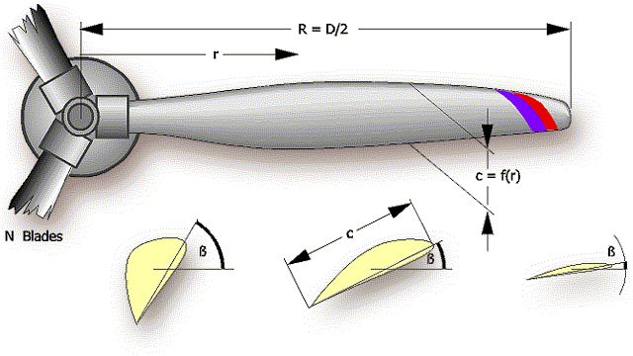
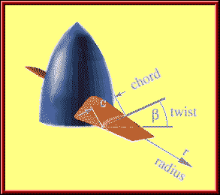



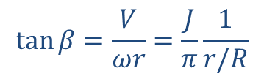
Propeller Geometry
For a constant pitch propeller
(most model airplane propellers)
$$\tan{β=\frac{V}{ωr}=\frac{J}{π}\frac{1}{r/R}}$$
$$Pitch ratio=pitch/D=π\tan{β}$$
$$V_{∞}$$
$$ωr$$
Pitch is defined as "the distance a propeller would move in one revolution if it were moving through a soft solid, like a screw through wood." For example, a 12-pitch propeller would move forward 12 inches in one revolution. Pitch ratio is usually a generalized comparator used to define groups of propeller type and operation. Generally, higher pitch ratio means higher operating speed.

Slide 3
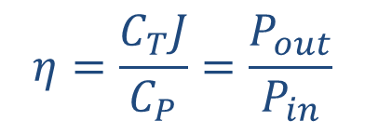
Propeller Parameters
Power coefficient Thrust coefficient Advance ratio
$$η=\frac{C_{T}J}{C_{P}}=\frac{P_{out}}{P_{in}}$$
Efficiency
ρ freestream density
n propeller revolutions per second
D propeller diameter [L units]
V freestream velocity [L /second units]

Slide 4
APC 12 x 6 E Propeller

Slide 5
APC 12 x 6 E Propeller

Slide 6
Propeller analysis
Gold.m
Gold Propeller Notes
JavaProp
Approximate Model
For conceptual and motor/propeller matching
Experimental and Calculation Data Bases
MotoCalc
http://www.mh-aerotools.de/airfoils/

Slide 7
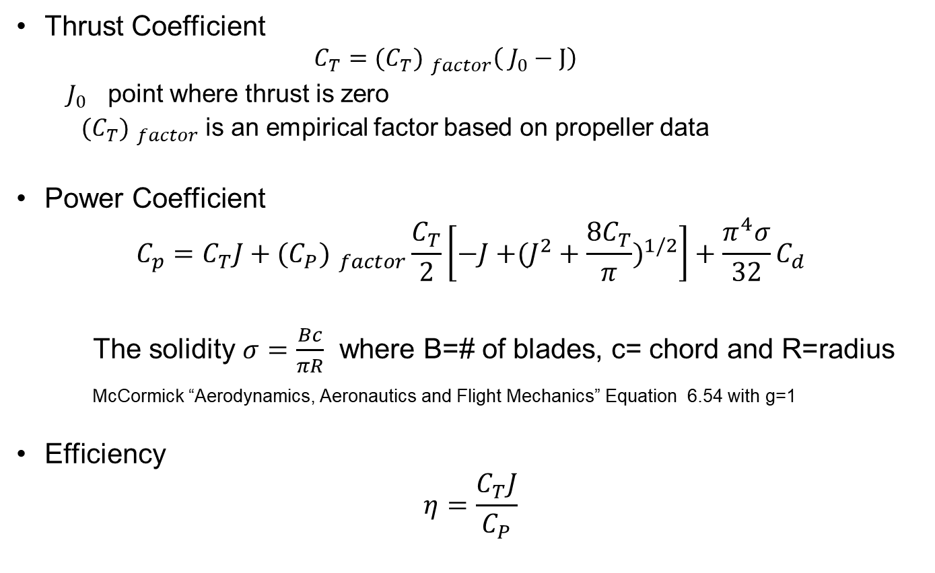
Approximate Model
Thrust Coefficient
$$C_{T}={{(C}_{T}) }_{factor}\left( J_{0}−J\right)$$
$J_{0}$ point where thrust is zero
${{(C}_{T}) }_{factor}$ is an empirical factor based on propeller data
Power Coefficient
$$C_{p}=C_{T}J+{{(C}_{P}) }_{factor}\frac{C_{T}}{2}\left[−J{+(J^{2}+\frac{8C_{T}}{π})}^{1/2}\right]+\frac{π^{4}σ}{32}C_{d}$$
The solidity $σ=\frac{Bc}{πR}$ where B=# of blades, c= chord and R=radius
McCormick “Aerodynamics, Aeronautics and Flight Mechanics” Equation 6.54 with g=1
Efficiency
$$η=\frac{C_{T}J}{C_{P}}$$

Slide 8
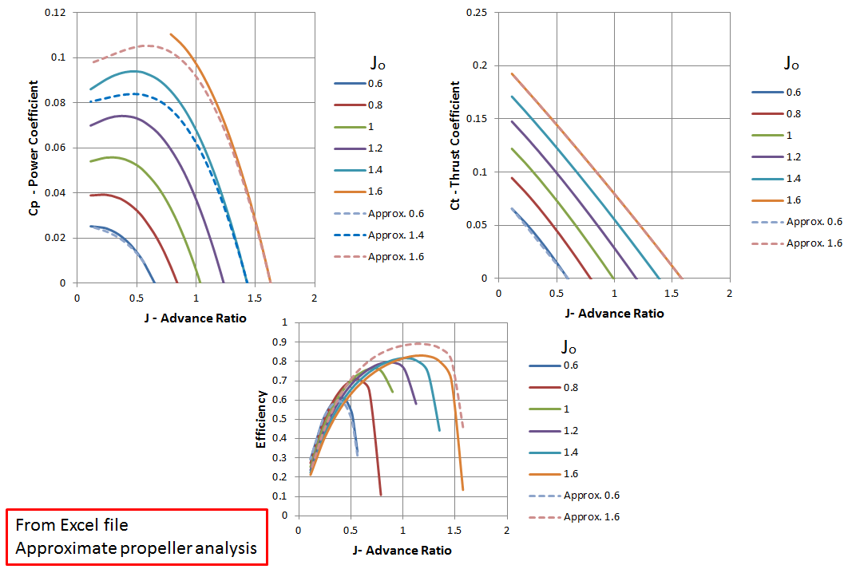
Comparison of Gold to Approximate Method
Increasing
Pitch
Increasing
Pitch
Increasing
Pitch

Slide 9
Comparison of UIUC Data to Approximate Method
http://aerospace.illinois.edu/m-selig/props/propDB.html
http://www.apcprop.com/v/downloads/PERFILES_WEB/datalist.asp

Slide 10
Comparison of UIUC Data to Approximate Method
http://aerospace.illinois.edu/m-selig/props/propDB.html
http://www.apcprop.com/v/downloads/PERFILES_WEB/datalist.asp

Slide 11
Sources of Propeller Data and Calculations
UIUC Propeller Data Base
https://m-selig.ae.illinois.edu/props/propDB.html
APC Propellers (https://www.apcprop.com/)
Calculation Data base
https://www.apcprop.com/technical-information/performance-data/

Slide 12
Some thoughts on practical application
APC Props has suggested RPM limits based on the type of propeller
In general, none of the projects in AerosPACE will be using a SF (slow flyer) propeller – they are light and thin, and have great data! But they could rip themselves apart if above the safe RPM.
Thin Electric (have an E in the prop name) are most widely used
Pusher props (nominal LH rotation instead of RH) are available as well
There are RC-sized props that are made with 3+ blades
Generally used for a “scale aircraft” look
Using a 3-bladed propeller to achieve the same thrust as a 2-bladed propeller of the same diameter will always be less efficient
Limited selection
Balance your propellers before you spin them up – vibrations destroy airframes
There must be a balance struck between takeoff and cruise performance

